Slide 1
Data Analytics and Visualization for Digital Forensics
Module 3, Day 5
Dr.ir. Hans Henseler,
University of Applied Sciences Leiden (NL)
Master of Advanced Studies in Digital Forensics & Cyber Investigation
Bern University of Applied Sciences

Slide 2
Module 3: Data Analytics and Visualization
This module teaches the use of data analytics and visualization for digital forensics. Topics covered include:
Log analysis and correlation
Event reconstruction using timelines
Using Plaso to create super-timelines
Working with Big Data repositories
Correlation and relationship analysis
Statistical analysis
Advanced search techniques

Slide 3
Day 5
Day 5 | Geo locations and final presentation
08:30 | Part 7: Analyzing and visualizing geolocation data
09:30 | Exercise 7: Plot geo locations from an Android phone + break
11:30 | Recap of what you have learned this week
12:00 | Lunch
13:00 | Project presentations (max 10 minutes pp)
15:00 | Break
15:30 | Evaluation and grading of projects
16:30 | End of the week!

Slide 4
Day 5: Learning Goals
Filtering and visualising location data
Working with Geopandas and Geoplot
Conversion of public IP addresses to geolocation
Understand the basics of geoprocessing
Deliver a digital forensics analytics and visualisation project and present it in front of an audience

Slide 5
Part 7: Analyzing and visualizing geolocation data

Slide 6
Geolocations & Digital Forensics
Use cases of spatical visualisation and processing in digital forensics:
Geotagging in:
pictures with geolocation in exif data, in social media etc.
Web history with url’s containing geo locations
Geomapping IP-addresses in a cyber investigation
Call-detail records
Apps with location based data:
weather forecasting apps, map apps, travel (e.g. Uber), traffic alerts, chat messages with geolocations
Mapping wifi networks

Slide 7

Visualising and processing geolocations
GeoPandas is an open-source project to make working with geospatial data in python easier (https://geopandas.org/).
GeoPandas extends the datatypes used by pandas to allow spatial operations on geometric types.
Geopandas is often combined with:
Shapely: package for manipulation and analysis of planar geometric objects
Fiona: reads and writes geographic data files
Descartes: integration of Shapely geometry objects with Matplotlib.

Slide 8
Geopandas: concepts
Extends popular data science library pandas by adding support for geospatial data
The core data structure in GeoPandas is geopandas.GeoDataFrame, a subclass of pandas.DataFrame able to store geometry columns and perform spatial operations.
Geometries are handled by geopandas.GeoSeries, a subclass of pandas.Series.
GeoDataFrame is a combination of Series with your data (numerical, boolean, text etc.) and GeoSeries with geometries (points, polygons etc.)

Slide 9
GeoSeries & Coordinate Reference System
Each GeoSeries can contain any geometry type (we can even mix them within a single array) and has a GeoSeries.crs attribute:
stores information on the projection (CRS stands for Coordinate Reference System)
Each GeoSeries in a GeoDataFrame can be in a different projection, allowing you to have, for example, multiple versions of the same geometry, just in a different CRS.

Slide 10
Reading and writing files
Reading files:
File formats that contain both data and geometry are, e.g., GeoPackage,GeoJSON and Shapely
The formats can be read with using geopandas.read_file which automatically detects filetype and creates a GeoDataFrame
Writing files:
Writing a GeoDataFrame back to file is similarly simple, using GeoDataFrame.to_file. The default file format is Shapefile, but you can specify your own using driver keyword.

Slide 11
Spatial joins
In a Spatial Join, two geometry objects are merged based on their spatial relationship to one another.
Example:
By joining a GeoDataFrame with Countries with a GeoDataFrame of locations we can immediately determine in which countries the locations are located.
The default spatial index in GeoPandas currently supports the following operations:
intersects, contains, within, touches, crosses, overlaps
As with SQL joins there you can join left, right or inner.

Slide 12
Spatial join: sjoin
Read geometries of all countries in the world (253 countries):
countries = gpd.read_file('1-introData/countries.gpkg')
Read geolocations of cities in the world (7.343 cities):
cities = gpd.read_file('1-introData/cities.geojson’)
Make cities coordinate reference system same as country crs:
cities.crs = ch_country.crs
Select geometry for Switzerland from countries:
ch_country = countries.loc[countries['NAME']=='Switzerland’]
Find all cities in Switzerland with sjoin:
ch_cities = sjoin(cities, ch_country, how="inner")

Slide 13
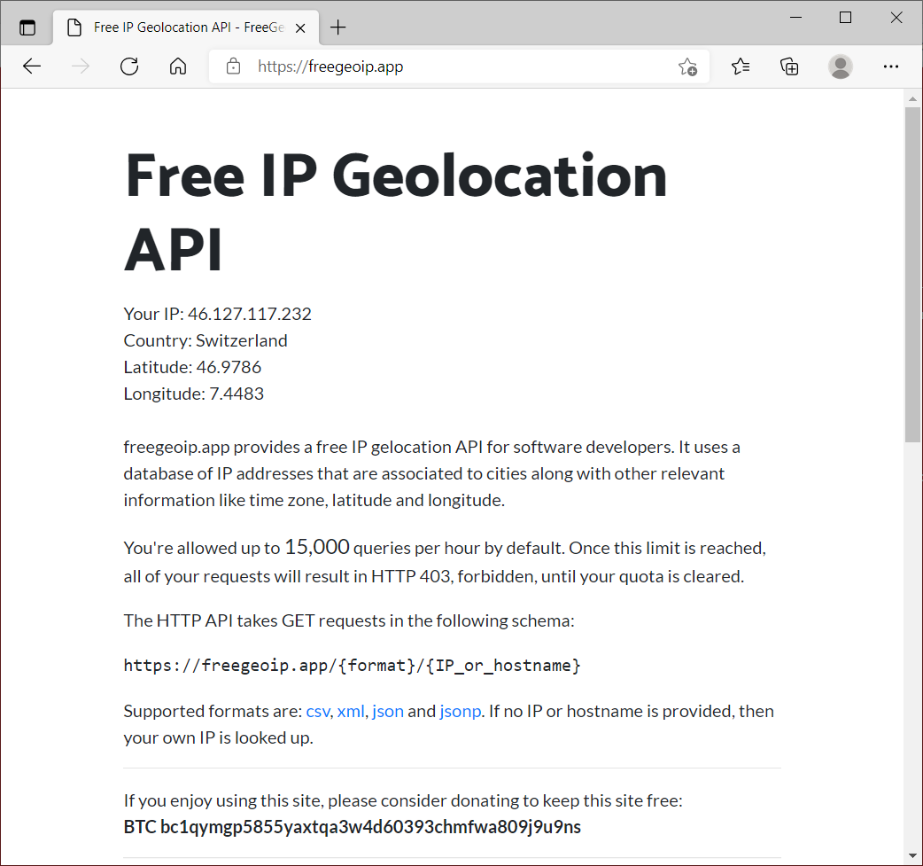
Plotting IP addresses
For example:
bfh = 'www.bfh.ch'
bfh_info= getting_ip(socket.gethostbyname(bfh))
bfh_info
{'city': 'Zurich',
'country_code': 'CH',
'country_name': 'Switzerland',
'ip': '94.230.211.116',
'latitude': 47.3682,
'longitude': 8.5671,
'metro_code': 0,
'region_code': 'ZH',
'region_name': 'Zurich',
'time_zone': 'Europe/Zurich',
'zip_code': '8004'}

Slide 14
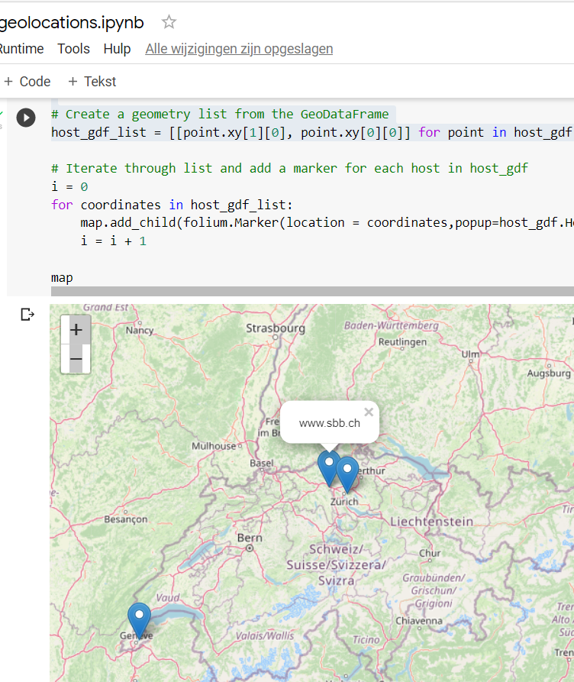
Folium Openstreetmap
Create DataFrame with Hostname and geolocations from freegeoip
Convert to GeoDataFrame
Create folium map based on Openstreetmap
Add markers for each host in de hostname with coordinates and hostname in popup.

Slide 15
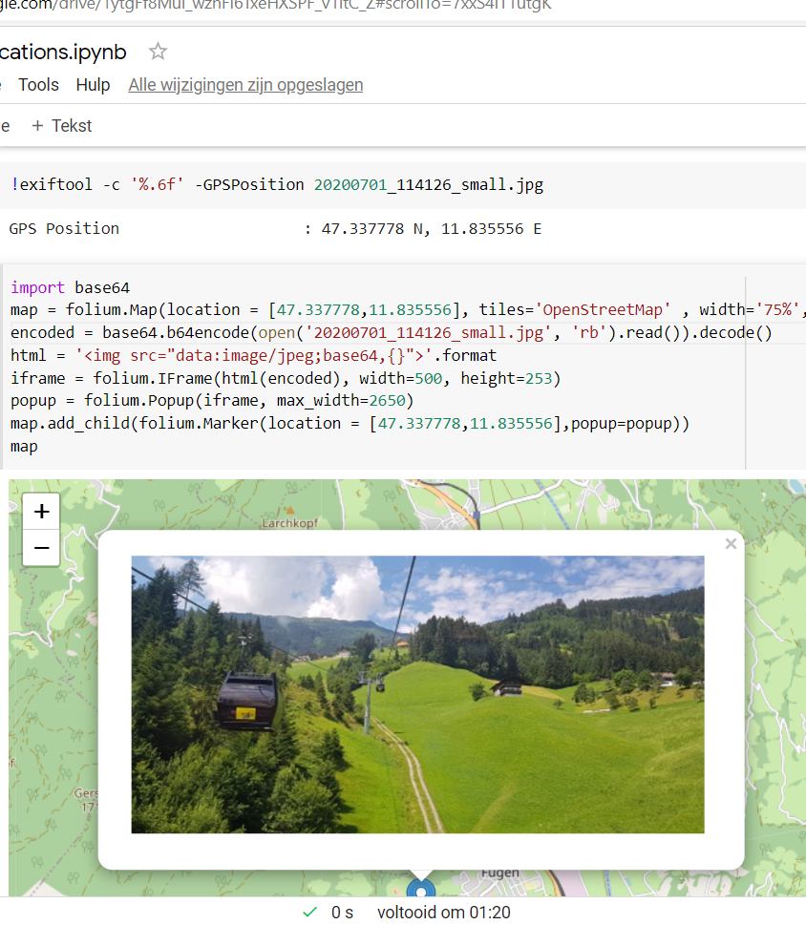
Geolocation of jpg picture
Extract geolocation from jpg with exiftool:
exiftool -c '%.6f' -GPSPosition 20200701_114126_small.jpg
Add marker to folium map:
map.add_child(folium.Marker(location = [47.337778,11.835556],popup=popup))

Slide 16

Exercise 7: Plot geo traces from Android 10
+ break
Lesson continues 11:30
+

Slide 17
Recap of what you have learned this week

Slide 18
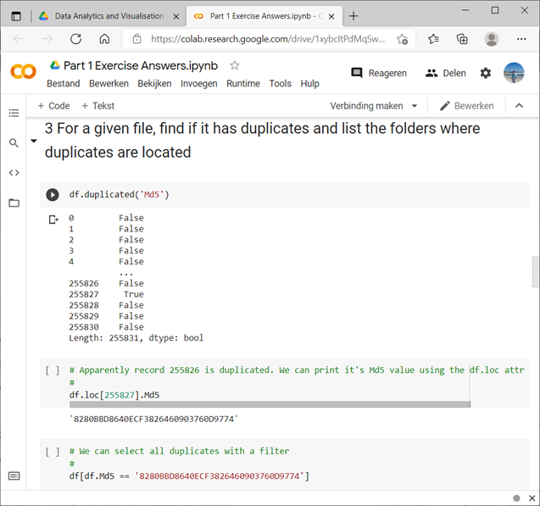
Part 1 Data analysis for DF
Quick introduction/refresher Python and Google Colaboratory
Working with Panda Dataframes
Pandas and statistical (analytical) operations
Cleaning data, filtering and sorting data

Slide 19
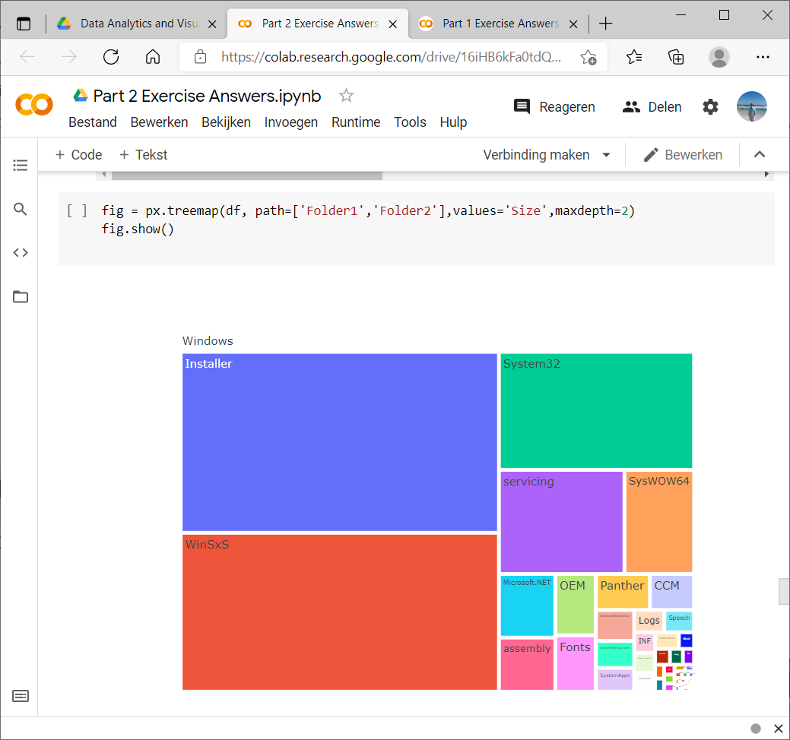
Part 2 Data visualisation for DF
Time series data visualisation
Line Plots
Histograms and Density Plots
Box and Whisker Plots
Heat Maps
Lag Plots or Scatter Plots
Autocorrelation Plots
Treemap and Sunburst
Wordcloud

Slide 20
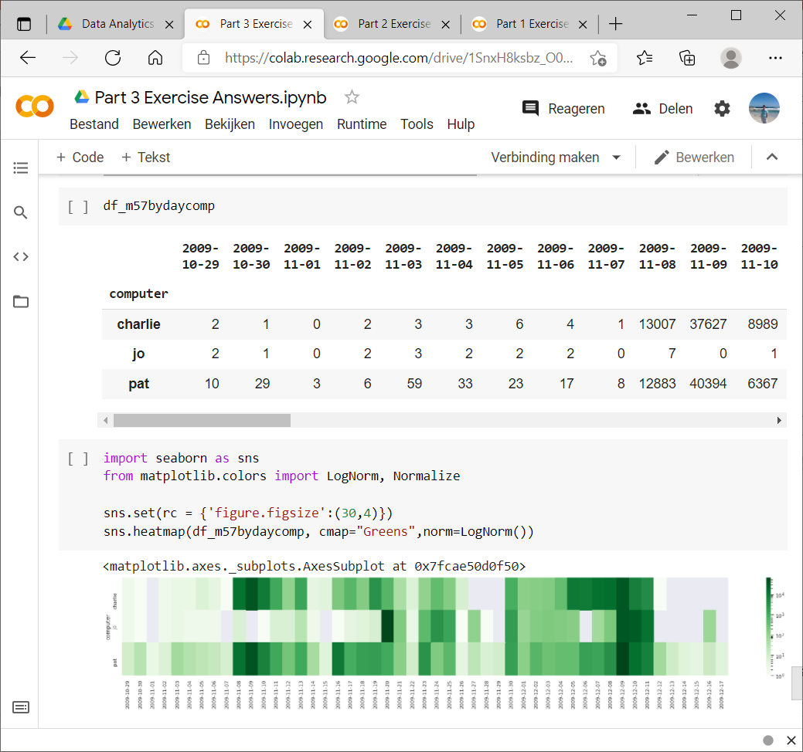
Part 3 Working with Plaso timelines
Understand and able to use Plaso tools:
Overview of supported sources and formats
Log2timeline, psort and pinfo
Visualisation of plaso output
Working with plaso output in Colab

Slide 21
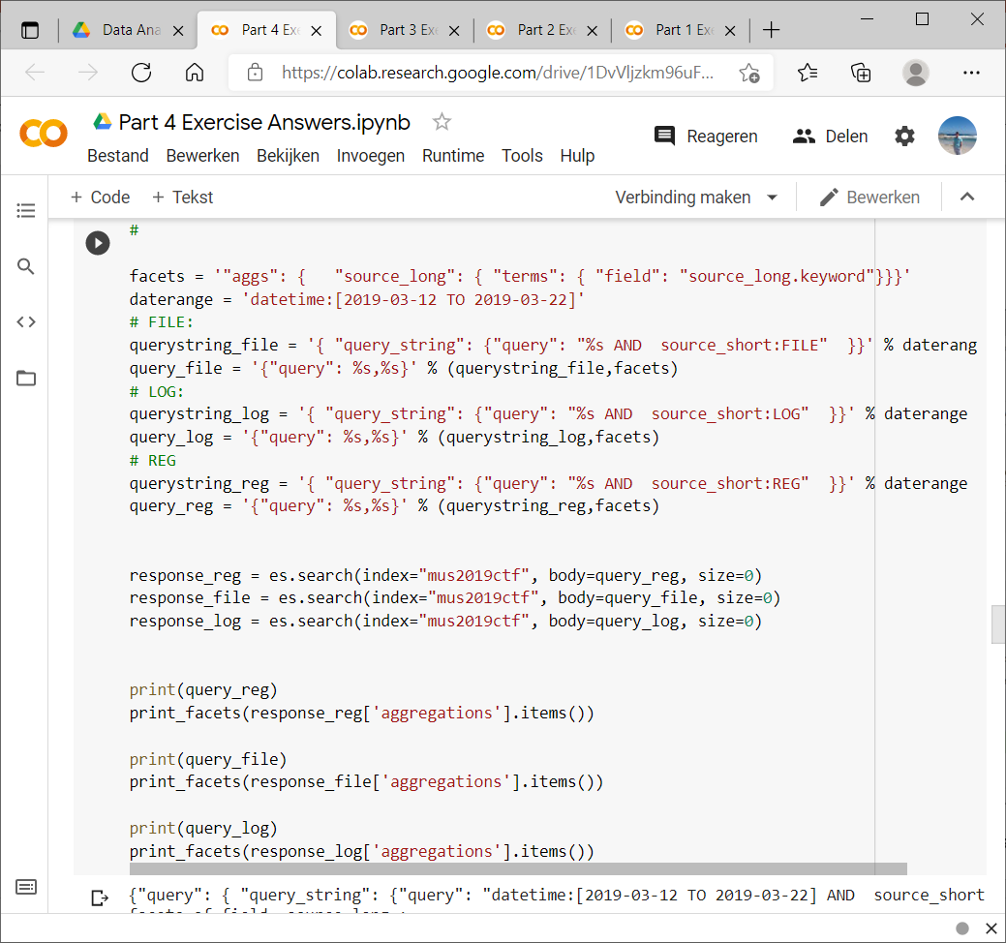
Part 4 Elasticsearch and log2timeline
Understand and able to use Elasticsearch:
Install Elasticsearch in Colab
Using the Elasticsearch python API
Filtering and aggregating results with Elasticsearch
Learn about practical use of Elasticsearch in digital forensics

Slide 22
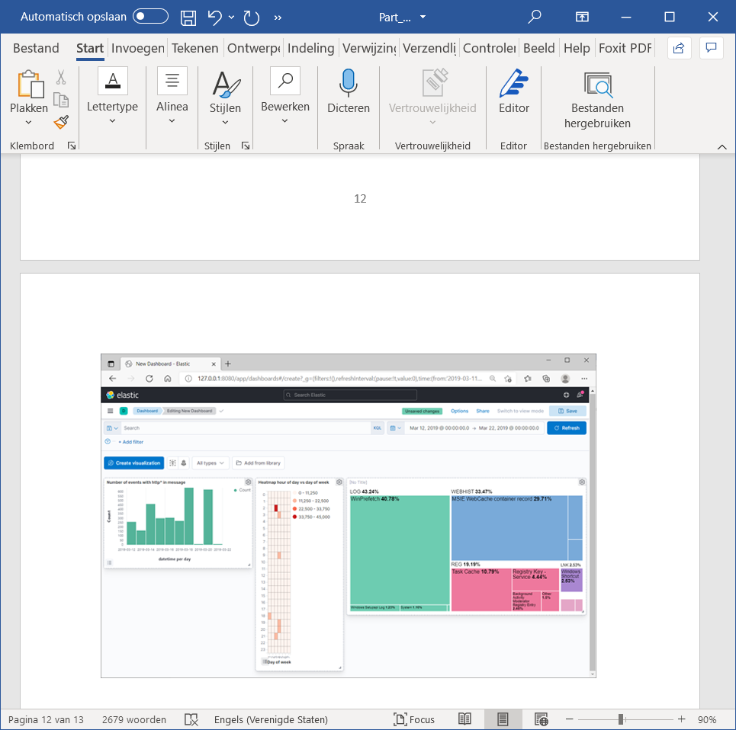
Part 5 Using Elasticsearch and Kibana
What is the ELK stack?
Work with ELK VM:
Load data with Psort.py in ES
Kibana index pattern
Kibana discover data
Kibana dashboard
Understand Big Data techniques in Hadoop and Spark
Design and setup a digital forensics analysis and visualisation project

Slide 23
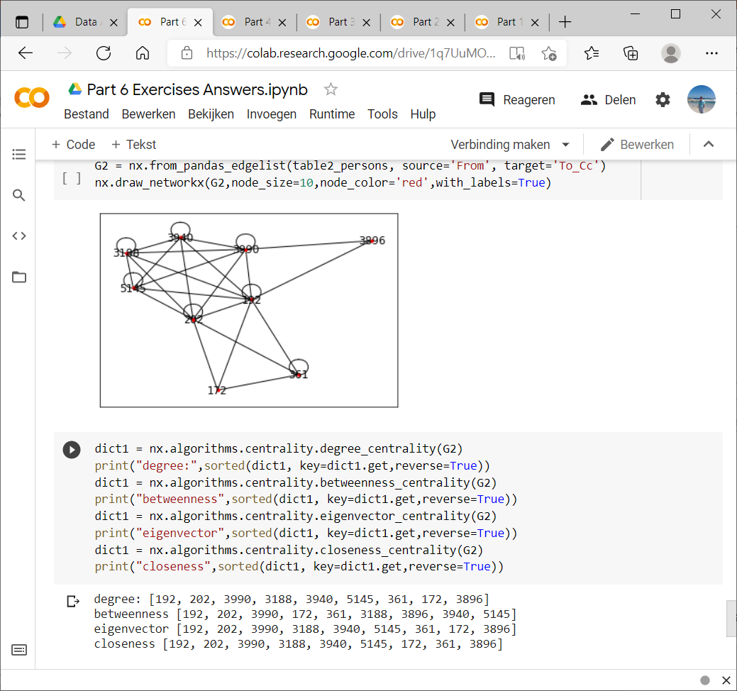
Part 6 Analyzing and visualising emails
Filtering and visualising email data
Use a heatmap to visualise email traffic density
Basics of social network (relationship) analysis
Visualising a graph network in Python
Full-text search strategies
Combining full-text search with facet search
Understand recall and precision

Slide 24
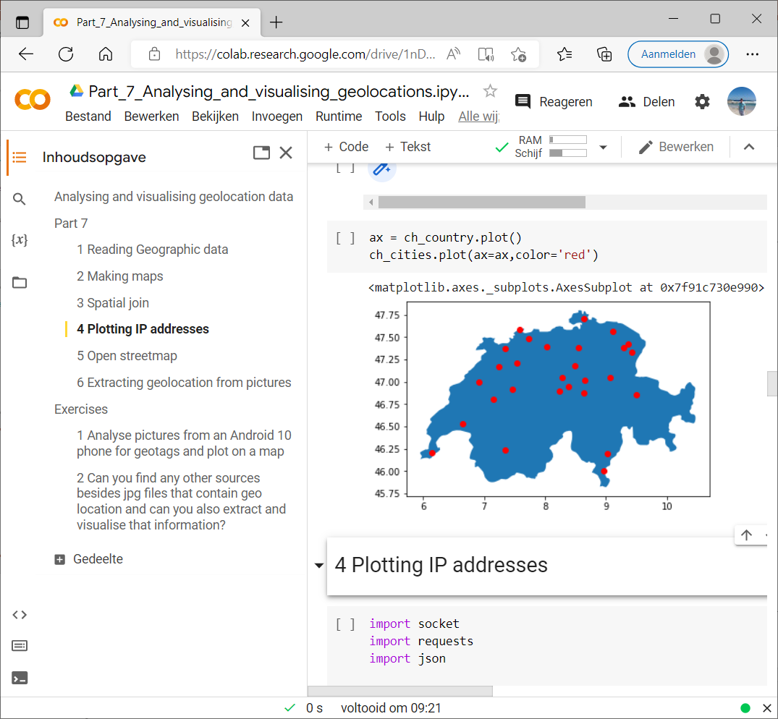
Part 7
Filtering and visualising location data
Working with Geopandas and Geoplot
Conversion of public IP addresses to geolocation
Understand the basics of geoprocessing
Deliver a digital forensics analytics and visualisation project and present it in front of an audience

Slide 26
Project presentations
13:00 – 15:00

Slide 27
15:00-15:30

Slide 28
Wrap up and evaluation

Slide 29

Goodbye!
Dr.ir. Hans Henseler
henseler.h@hsleiden.nl

